Slide 1

Robot Navigation by Reinforcement Learning
Final project by Team 10
EEE 598, Fall 2024
Kannak Sharma, Lili Ye, and Zeming Zhou
School of Electrical, Computer, and Energy Engineering,
Arizona State University
Contacts: [ksharm88, liliye, zzhou157]@asu.edu

Slide 2
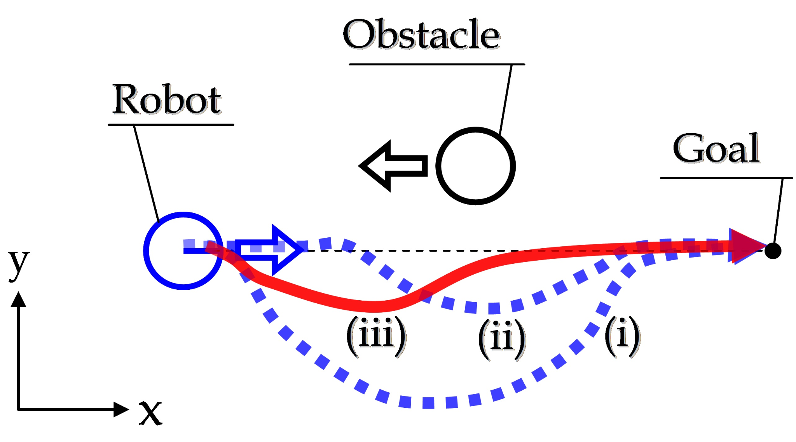
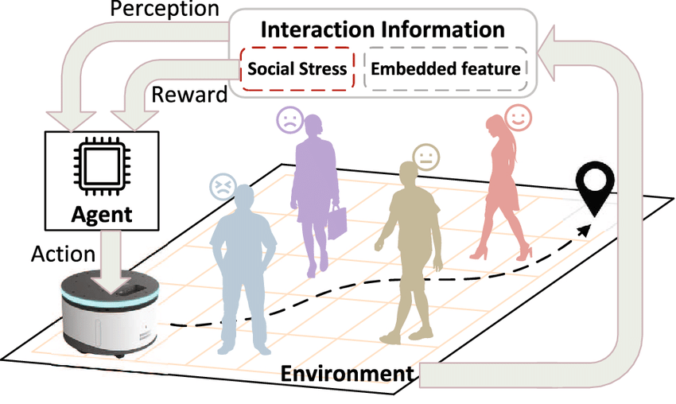
What is the issue/prompt under discussion
Objective
Develop adaptable, collision-free navigation for robots in unstructured settings using RL and PPO algorithms.
Key Challenges in Modern Navigation
Obstacle Avoidance: Navigate around static (e.g., walls) and dynamic obstacles (e.g., people, other robots).
Real-Time Decision Making: Rapidly process continuous data for immediate response.
Limited Sensory Data: Operate with incomplete view of surroundings using local sensors (e.g., LiDAR).
Adaptability: Generalize navigation strategies across various environments without reprogramming.
Fig. A situation of obstacle avoidance
Source: link
current practice
Fig. Robot navigation in the complex dynamic environment with multi-human interaction. Source: link

Slide 3
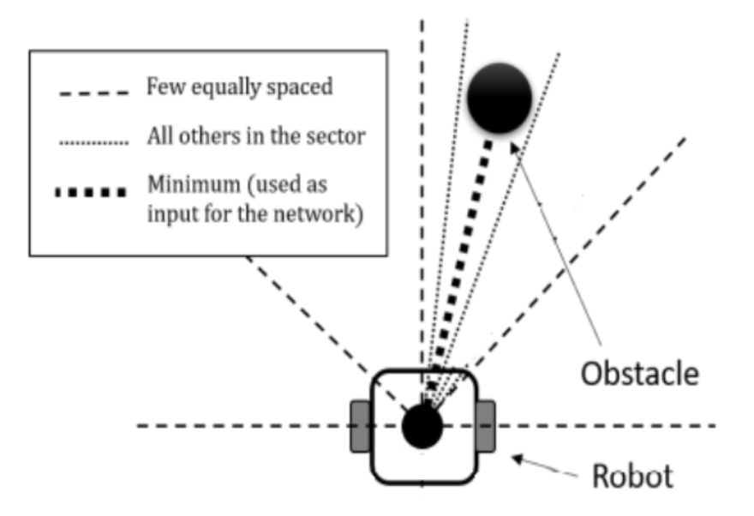
What is the issue/prompt under discussion
Why Traditional Methods Fall Short
Lack of flexibility to handle unexpected obstacles or changes in environment layout.
1. Dynamic Obstacles 2. Reactive Navigation Challenges 3. Real-Time Data Limitations
Dependence on predefined maps makes traditional methods unsuitable for unstructured and dynamic settings.
1. Static Nature 2. Unstructured Settings 3. Limited Scalability
Our Approach
Proximal Policy Optimization (PPO): Reliable for continuous action spaces, ideal for dynamic navigation.
Actor-Critic Model: Enhances decision-making by evaluating actions for a balanced, adaptive response.
LiDAR Integration: Enables real-time adjustments without reliance on pre-defined maps.
current practice
Fig. LiDAR-based obstacle detection: minimum distance in sector used as input for PPO network
Notes:
Static Nature: Traditional navigation methods rely heavily on pre-constructed, static maps of the environment. These maps are fixed representations and cannot accommodate real-time changes in the robot's surroundings.
Unstructured Settings: In dynamic environments such as warehouses or crowded public spaces, the layout can change frequently (e.g., people moving, obstacles shifting). Pre-defined maps fail to adapt, rendering the robot unable to navigate effectively.
Limited Scalability: Robots using these methods cannot generalize to new or unseen environments without extensive reprogramming or manual map updates.
Lack of Flexibility to Handle Unexpected Obstacles
Dynamic Obstacles: Traditional methods struggle with moving obstacles like humans or other robots, as they rely on pre-planned paths that don't account for real-time changes.
Reactive Navigation Challenges: These methods lack mechanisms for continuous learning or decision-making, making it difficult to respond to unexpected barriers or sudden changes in the environment.
Real-Time Data Limitations: Without leveraging sensory inputs like LiDAR or reinforcement learning frameworks, traditional approaches cannot process real-time data to adjust navigation dynamically.

Slide 4
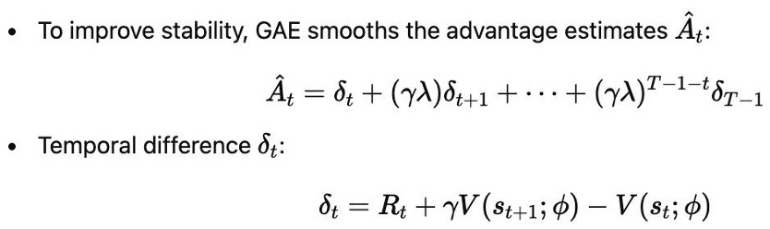
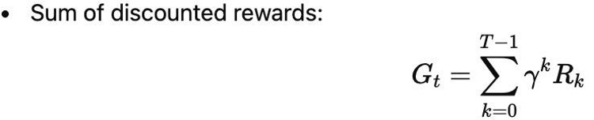
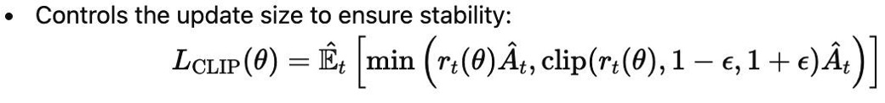
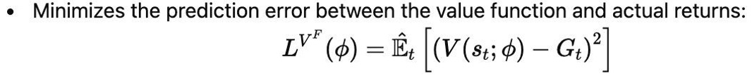
PPO Algorithm - Key Components and Formulas
1.Generalized Advantage Estimation (GAE)
2. Return Calculation
3. Clipped Surrogate Objective
4. Value Function Loss

Slide 5
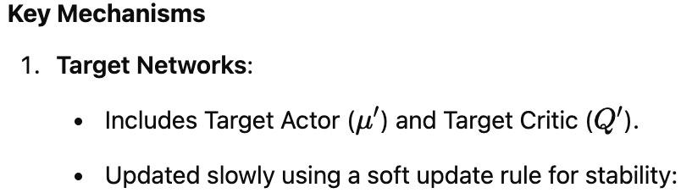
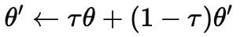
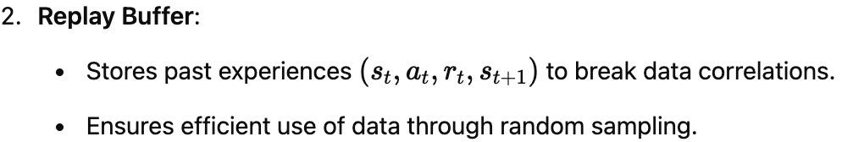
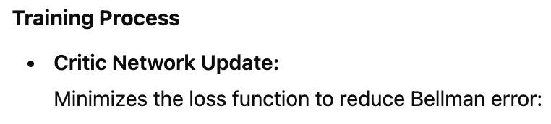
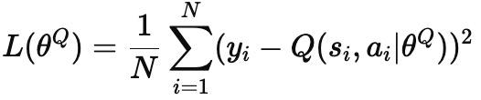
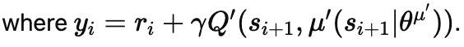
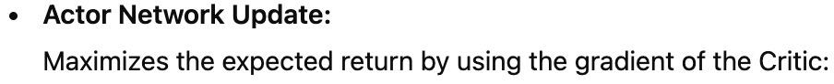
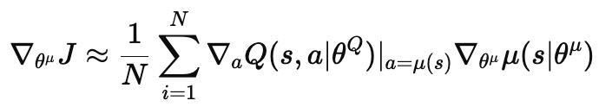
Deep Deterministic Policy Gradient (DDPG)

Slide 6
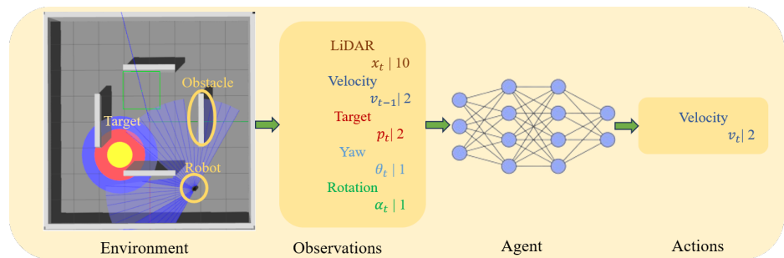
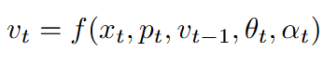
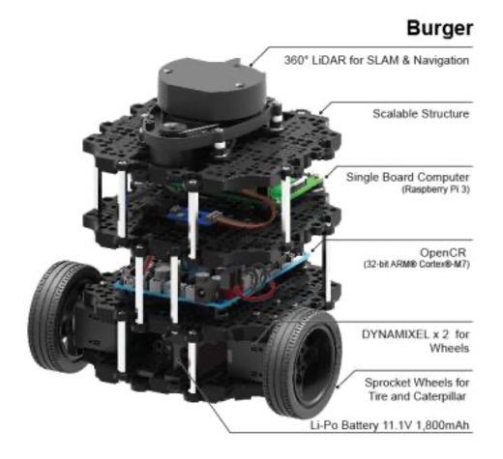
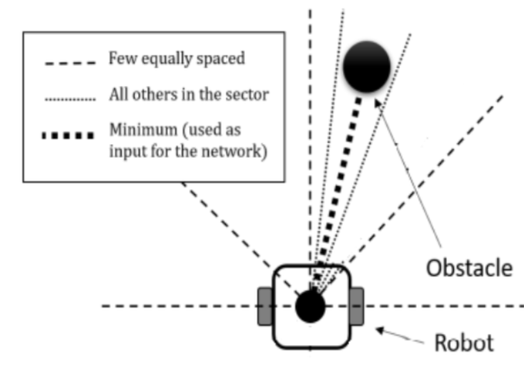
Problem Setup
H. Taheri and S. R. Hosseini, “Deep re-inforcement learning with enhanced PPO forsafe mobile robot navigation,” arXiv preprintarXiv:2405.16266, 2024

Slide 7
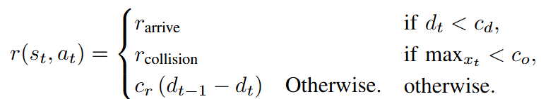
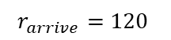
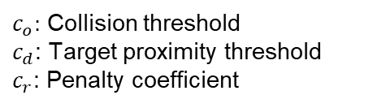
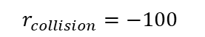

Problem Setup
Training details:
Episodic training: When collision or max time step = 800 or arrive the target
Batch size = 8000 time steps
Epochs = 100 steps with Adam optimizer for gradient descent
H. Taheri and S. R. Hosseini, “Deep re-inforcement learning with enhanced PPO forsafe mobile robot navigation,” arXiv preprintarXiv:2405.16266, 2024

Slide 8
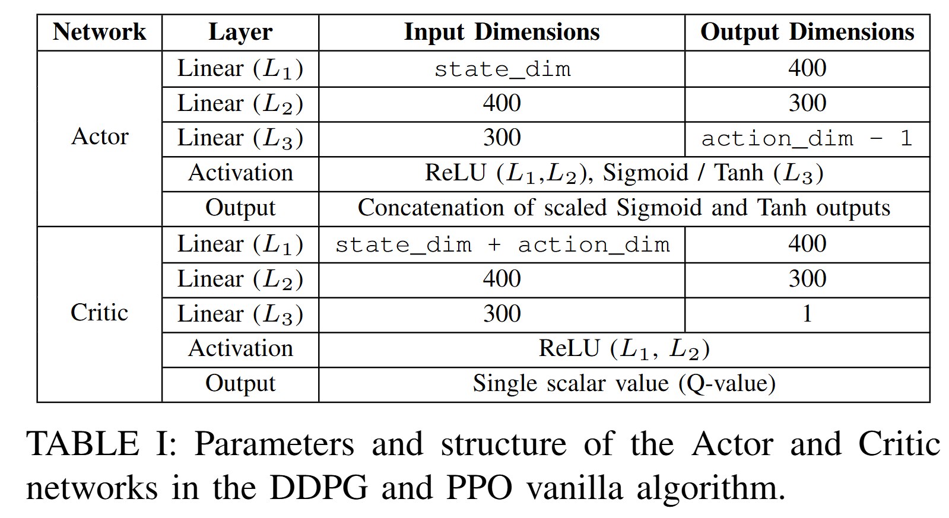

Model Architecture: DDPG and PPO Vanilla in Code

Slide 9
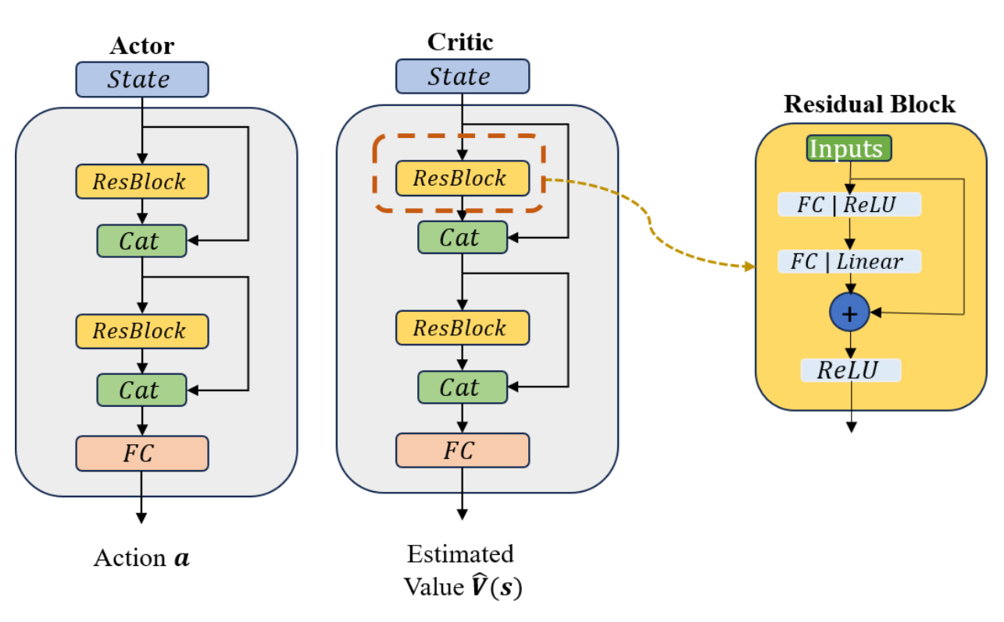
Model architecture: Proposed PPO in Paper
H. Taheri and S. R. Hosseini, “Deep re-inforcement learning with enhanced PPO forsafe mobile robot navigation,” arXiv preprintarXiv:2405.16266, 2024

Slide 10

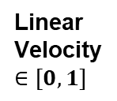
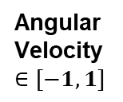
Model architecture: Proposed PPO in Code
Actor
Critic
State
Residual Block 1
Residual Block 2
State
Input (16)
F Input (32)
ResBlock 1
ResBlock 1
FC (16x512)/ReLU
FC (32x512)/ReLU
Cat
Cat
FC (512x16)/Linear
FC (512x32)/Linear
ResBlock 2
ResBlock 2
ReLU
ReLU
FC (32x2)
Output (16)
Output (32)
FC (32x1)
Sigmoid
tanh
Clip
Mean Value of Action
Action
+ Gaussian noise

Slide 11
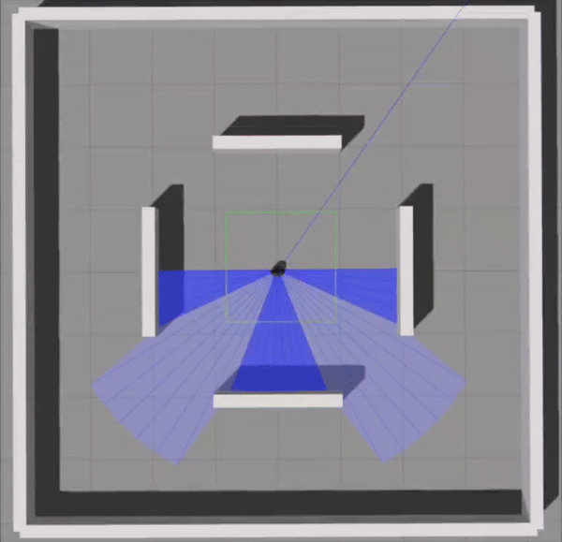
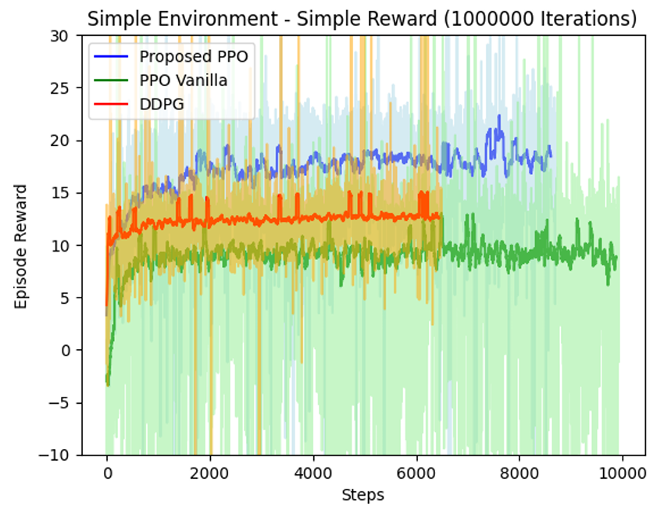
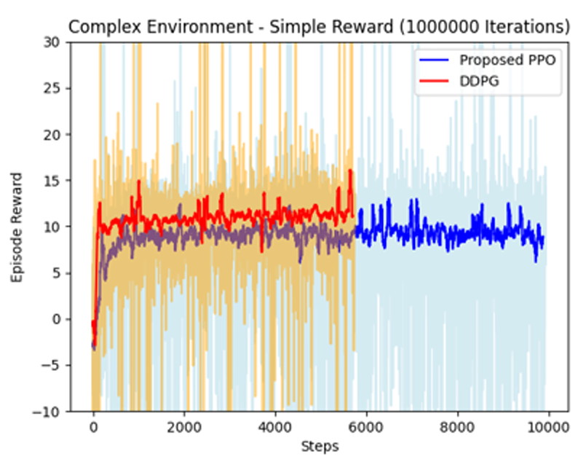
Performance in Paper
.gif
https://github.com/hamidthri/navbot_ppo
H. Taheri and S. R. Hosseini, “Deep re-inforcement learning with enhanced PPO forsafe mobile robot navigation,” arXiv preprintarXiv:2405.16266, 2024

Slide 12
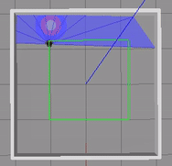
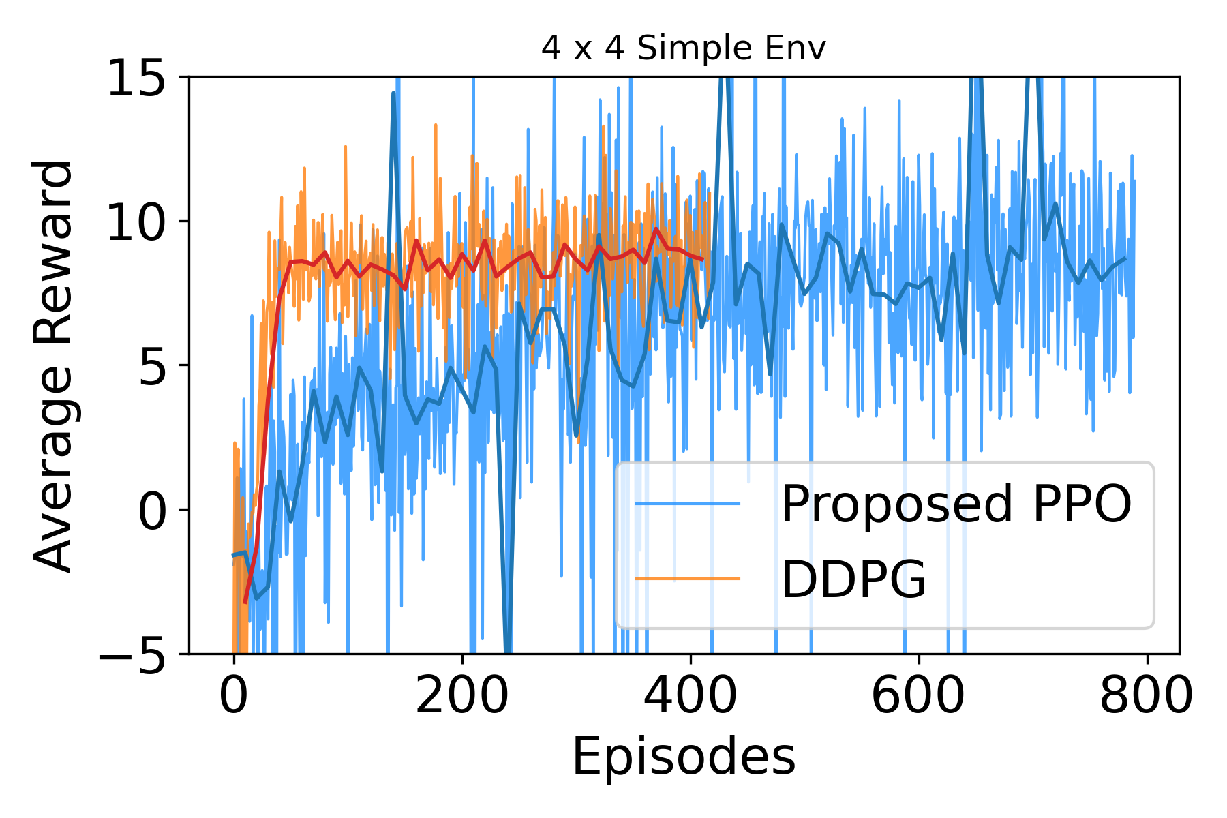
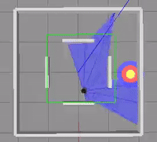
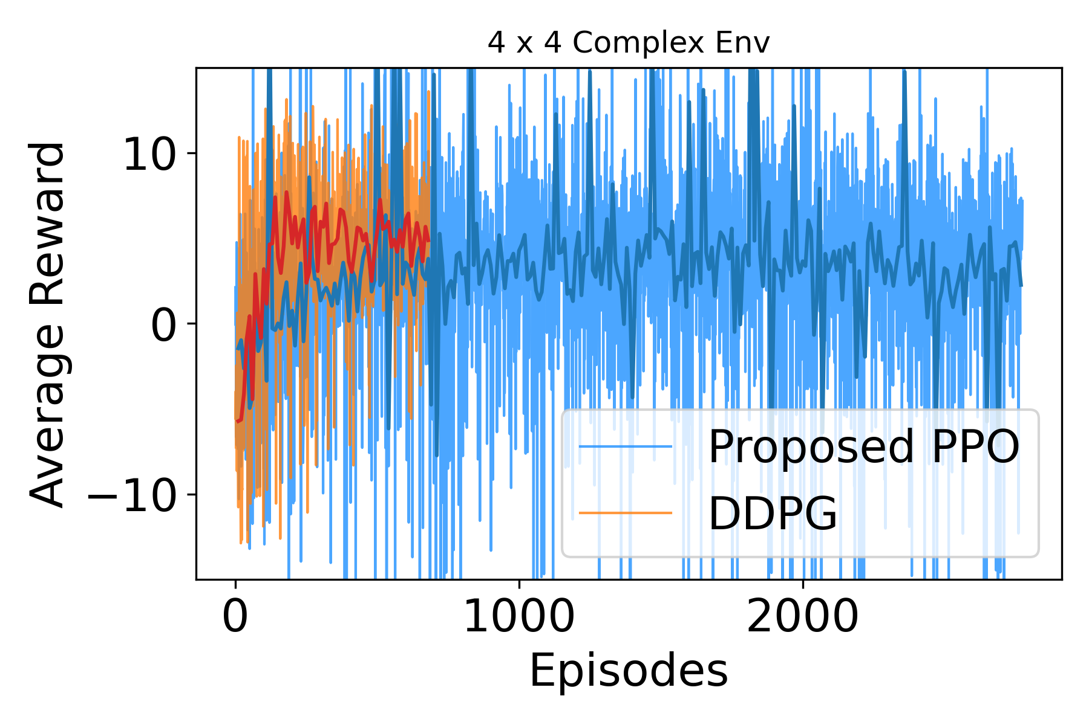
Performance in Code
.gif
https://github.com/liliyequantum/RL_in_robotics
H. Taheri and S. R. Hosseini, “Deep re-inforcement learning with enhanced PPO forsafe mobile robot navigation,” arXiv preprintarXiv:2405.16266, 2024

Slide 13
Future Work
Q1: The proposed PPO shows the slower convergence speed compared to DDPG
Q2: The Converged reward of the proposed PPO is similar or slightly worse than DDPG in 4 x 4 environments
A1: Increase learning rate, reduce neurons in Residual Block layers or change the network structure of it
A2: Adjust PPO's initial noise level in stochastic policy to enhance reward convergence.
Exploration vs. Exploitation trade-off plays a crucial role in final reward values.

Slide 14
References
Papers cited | How is the paper used (specifics) | Remarks (if any)
[1] H. Taheri and S. R. Hosseini, “Deep reinforcement learning with enhanced PPO for safe mobile robot navigation,” arXiv preprint arXiv:2405.16266, 2024 | We relied extensively on this paper across Sections I through V to develop the PPO agent for robot navigation.
[2] Z. Liu, Y. Zhai, J. Li, G. Wang, Y. Miao, and H. Wang, “Graph relational reinforcement learning for mobile robot navigation in large-scale crowded environments,” IEEE Transactions on Intelligent Transportation Systems, 2023. | We use this paper to introduce Graph Relational Reinforcement Learning (GRRL) for robot navigation in Section I.
[3] Z. Wang, Y. Wang, Z. Wang, H. Yan, Z. Xu, and Z. Wu, “Research on autonomous robots navigation based on reinforcement learning,” in 2024 3rd International Conference on Robotics, Artificial Intelligence and Intelligent Control (RAIIC). IEEE, 2024. | We use this paper to introduce Deep Q-Networks for robot navigation in Section I.

